Slide 1
Feature engineering

Slide 2
Feature engineering
refers to the process of using domain knowledge to select and transform the most relevant variables from raw data
The goal of feature engineering and selection is to improve the performance of machine learning (ML) algorithms.
The feature engineering pipeline is preprocessing steps that transform raw data into features that can be used in machine learning algorithms, such as predictive models.
Predictive models consist of an outcome variable and predictor variables, and it is during the feature engineering process that the most useful predictor variables are created and selected for the predictive model.

Slide 3
Steps
Creation
Transformation
Extraction
Selection

Slide 4
Steps
Feature Creation:
Creating features involves identifying the variables that will be most useful in the predictive model.
This is a subjective process that requires human intervention and creativity.
Existing features are mixed via addition, subtraction, multiplication, and ratio to create new derived features that have greater predictive power.
Transformations:
Transformation involves manipulating the predictor variables to improve model performance;
ensuring the model is flexible in the variety of data it can ingest
ensuring variables are on the same scale
making the model easier to understand
improving accuracy
and avoiding computational errors by ensuring all features are within an acceptable range for the model.

Slide 5
Steps
Feature Extraction:
is the automatic creation of new variables by extracting them from raw data.
The purpose of this step is to automatically reduce the volume of data into a more manageable set for modeling.
Some feature extraction methods include cluster analysis, text analytics, edge detection algorithms, and principal components analysis.
Feature Selection:
algorithms essentially analyze, judge, and rank various features to determine which features are irrelevant and should be removed
which features are redundant and should be removed
which features are most useful for the model and should be prioritized.

Slide 6
Tricks with Simple Numbers

Slide 7
Scalars, Vectors, and Spaces
A single numeric feature is also known as a scalar.
An ordered list of scalars is known as a vector.
Vectors sit within a vector space.
In the vast majority of machine learning applications, the input to a model is usually represented as a numeric vector
A vector can be visualized as a point in space.
For instance, suppose we have a two-dimensional vector v = [1, –1].

Slide 8
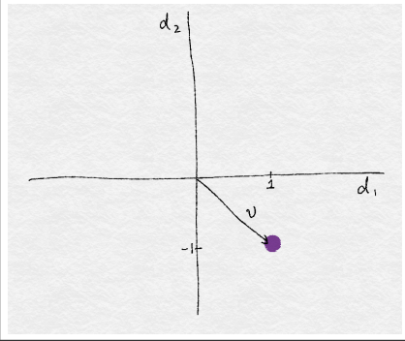
Vectors

Slide 9
Quantization or Binning
Data binning, also called discrete binning or bucketing
is a data pre-processing technique used to reduce the effects of minor observation errors.
It is a form of quantization: The original data values are divided into small intervals known as bins
then they are replaced by a general value calculated for that bin.

Slide 10
Statistical data binning
is a way to group numbers of more or less continuous values into a smaller number of "bins".
It can also be used in multivariate statistics, binning in several dimensions simultaneously.
For example, if you have data about a group of people, you might want to arrange their ages into a smaller number of age intervals, such as grouping every five years together.
Binning can dramatically improve resource utilization and model build response time without significant loss in model quality.
Binning can improve model quality by strengthening the relationship between attributes.

Slide 11
Supervised binning
is a form of intelligent binning in which important characteristics of the data are used to determine the bin boundaries.
In supervised binning, the bin boundaries are identified by a single-predictor decision tree that considers the joint distribution with the target.
Supervised binning can be used for both numerical and categorical attributes.
There are two types of binning techniques: 1. Fixed-Width Binning 2. Adaptive Binning

Slide 12
Fixed-Width Binning
We manually create fix width bins based on some rules and domain knowledge. Consider that we have following 15 values in the age column: age = [12, 15, 13, 78, 65, 42, 98, 24, 26, 38, 27, 32, 22, 45, 27] Now, lets create bins of fixed width (say 10): bins = [0 {0-9}, 1 {10-19}, 2 {20-29}, 3 {30-39}, 4 {40-49}, 5 {50-59}, 6 {60-69}, 7 {70-79}, 8 {80-89}, 9 {90-99}] After binning, our age variable looks like this: age = [1, 1, 1, 7, 6, 4, 9, 2, 2, 3, 2, 3, 2, 4, 2] In this way, all the 15 values will fit in above 10 ranges / bins. Just think of a dataset containing thousands of values in the age column instead of just 15! How useful it would be in this case!

Slide 13
Adaptive Binning
In Fixed-Width Binning, bin ranges are manually decided.
So, we usually end up in creating irregular bins which are not uniform based on the number of data points or values which fall under each bin.
Some of the bins might be densely populated and some of them might be sparsely populated or even empty. For example, bins 0, 5 and 8 are empty in our case. In Adaptive Binning, data distribution itself decides bin ranges for itself.
No manual intervention is required. So, the bins which are created are uniform in terms of number of data points in it.

Slide 14
Adaptive Binning
Quantile
based binning is a good strategy to use for adaptive binning.
Quantiles are specific values or cut-points which help in partitioning the continuous valued distribution of a specific numeric field into discrete contiguous bins or intervals.
Thus, q-Quantiles help in partitioning a numeric attribute into q equal partitions.
Popular examples of quantiles include the 2-Quantile known as the median which divides the data distribution into two equal bins,
4-Quantiles known as the quartiles which divide the data into 4 equal bins
10-Quantiles also known as the deciles which create 10 equal width bins.

Slide 15
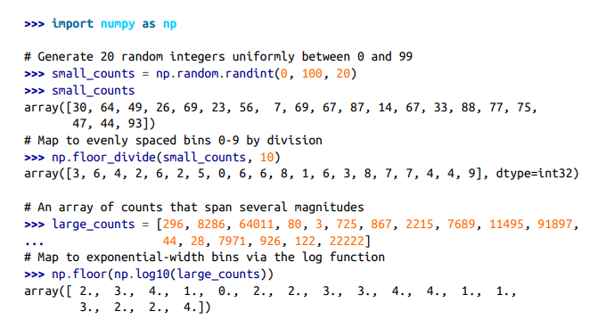
Fixed-width binning (Python)

Slide 16
Yelp dataset
The Yelp dataset contains user reviews of businesses from 10 cities across North America and Europe.
Each business is labeled with zero or more categories.
There are 782 business categories.
The full dataset contains 1,569,264 (≈1.6M) reviews and 61,184 (61K) businesses.
“Restaurants” (990,627 reviews) and “Nightlife” (210,028 reviews) are the most popular categories, review count–wise.
No business is categorized as both a restaurant and a nightlife venue. So, there is no overlap between the two groups of reviews.

Slide 17
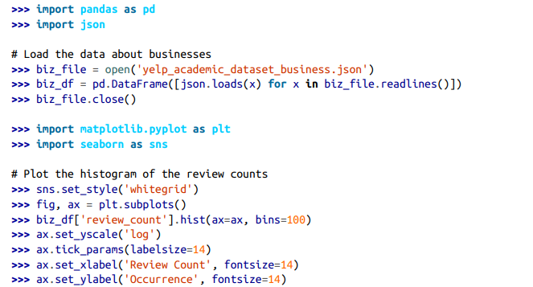
Visualization Yelp dataset

Slide 18
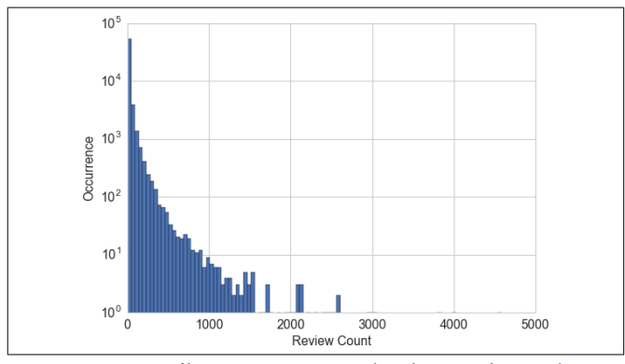
Visualization Yelp dataset

Slide 19
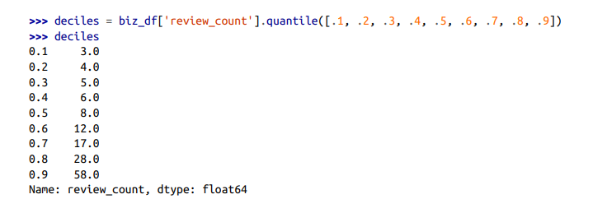
Quantile binning

Slide 20
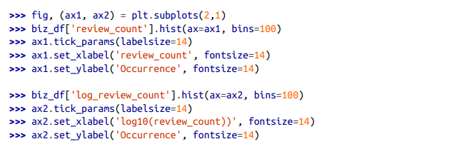
Log Transformation Visualizing the distribution of review counts before and after log transform

Slide 21
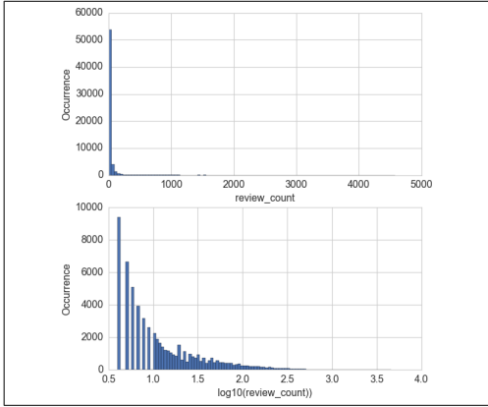
Log Transformation Visualizing the distribution of review counts before and after log transform

Slide 22
Feature Scaling or Normalization
Some features, such as latitude or longitude, are bounded in value.
Other numeric features, such as counts, may increase without bound.
Models that are smooth functions of the input, such as linear regression, logistic regression, or anything that involves a matrix, are affected by the scale of the input.
Tree-based models, on the other hand, couldn’t care less.
If your model is sensitive to the scale of input features, feature scaling could help.
As the name suggests, feature scaling changes the scale of the feature.

Slide 23

Min-Max Normalization
Min-max normalization is one of the most common ways to normalize data.
For every feature, the minimum value of that feature gets transformed into a 0, the maximum value gets transformed into a 1,
every other value gets transformed into a decimal between 0 and 1.
For example, if the minimum value of a feature was 20, and the maximum value was 40, then 30 would be transformed to about 0.5 since it is halfway between 20 and 40. The formula is as follows:

Slide 24
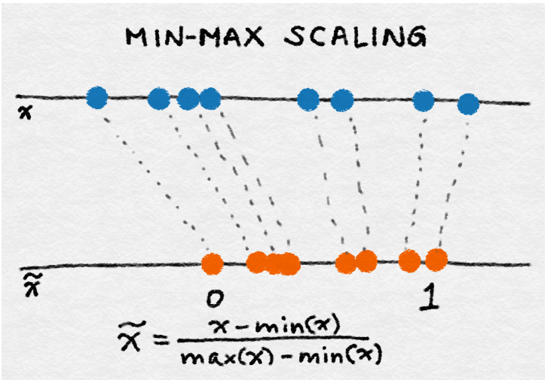
Min-Max Normalization

Slide 25
Example
For example, for a dataset, we could guesstimate the min and max observable values as 30 and -10. We can then normalize any value, like 18.8, as follows:
y = (x – min) / (max – min)
y = (18.8 – (-10)) / (30 – (-10))
y = 28.8 / 40
y = 0.72

Slide 26

Standardization (Variance Scaling)
Standardization is another scaling method where the values are centered around the mean with a unit standard deviation.
This means that the mean of the attribute becomes zero, and the resultant distribution has a unit standard deviation.

Slide 27
Standardization
Standardization assumes that your observations fit a Gaussian distribution (bell curve) with a well-behaved mean and standard deviation.
You can still standardize your data if this expectation is not met, but you m
Standardization requires that you know or are able to accurately estimate the mean and standard deviation of observable values.
You may be able to estimate these values from your training data, not the entire dataset. ay not get reliable results.

Slide 28
Example
We can guesstimate a mean of 10.0 and a standard deviation of about 5.0. Using these values, we can standardize the first value of 20.7 as follows:
y = (x – mean) / standard_deviation
y = (20.7 – 10) / 5
y = (10.7) / 5
y = 2.14

Slide 29
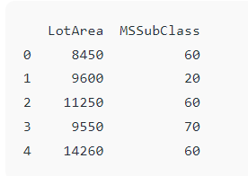
Data
import pandas as pd
df = pd.read_csv('SampleFile.csv')
print(df.head())

Slide 30
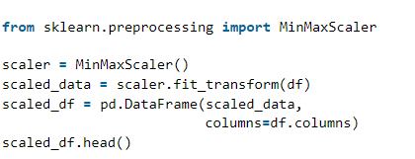
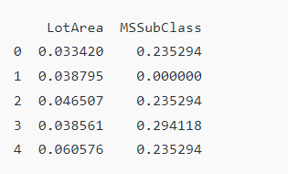
Min-Max

Slide 31
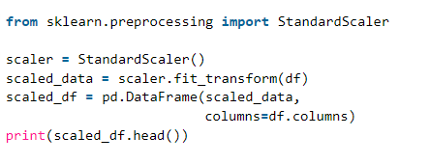
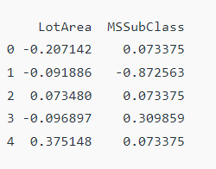
Standardization

